Slide 1
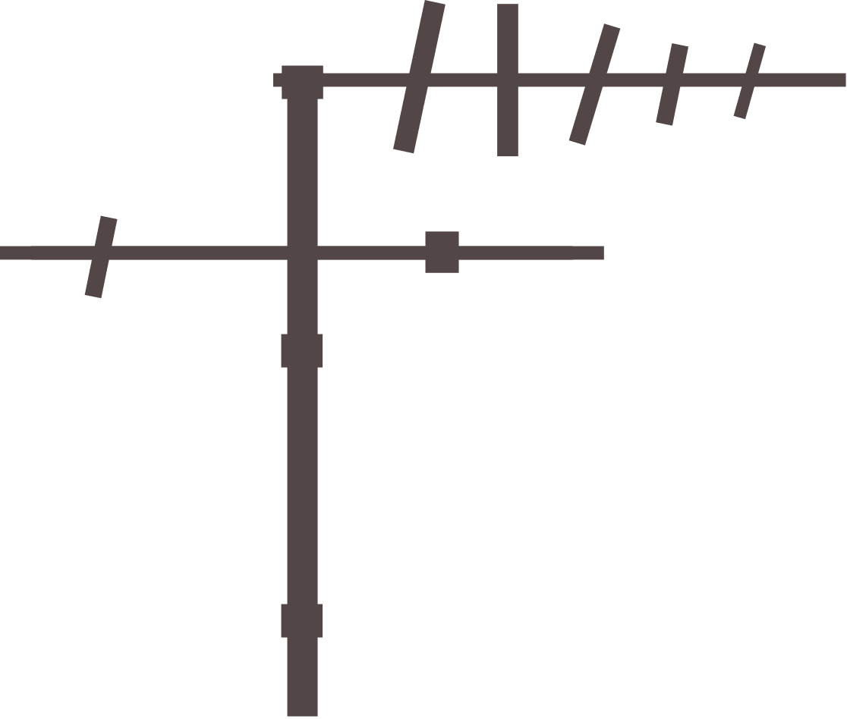
Signals in Godot
An introduction to using signals in Godot 4

Slide 2
Definition of Terms
Node
Built-ins
Variant
Callable
Signal

Slide 3
What is a Node in Godot?
A "node" is a fundamental building block of a scene. A node represents an entity or an object within a game or application and is used to structure and organize the components of your project. Nodes in Godot are organized in a hierarchical tree structure, where each node can have one parent and multiple children, creating a parent-child relationship.

Slide 4
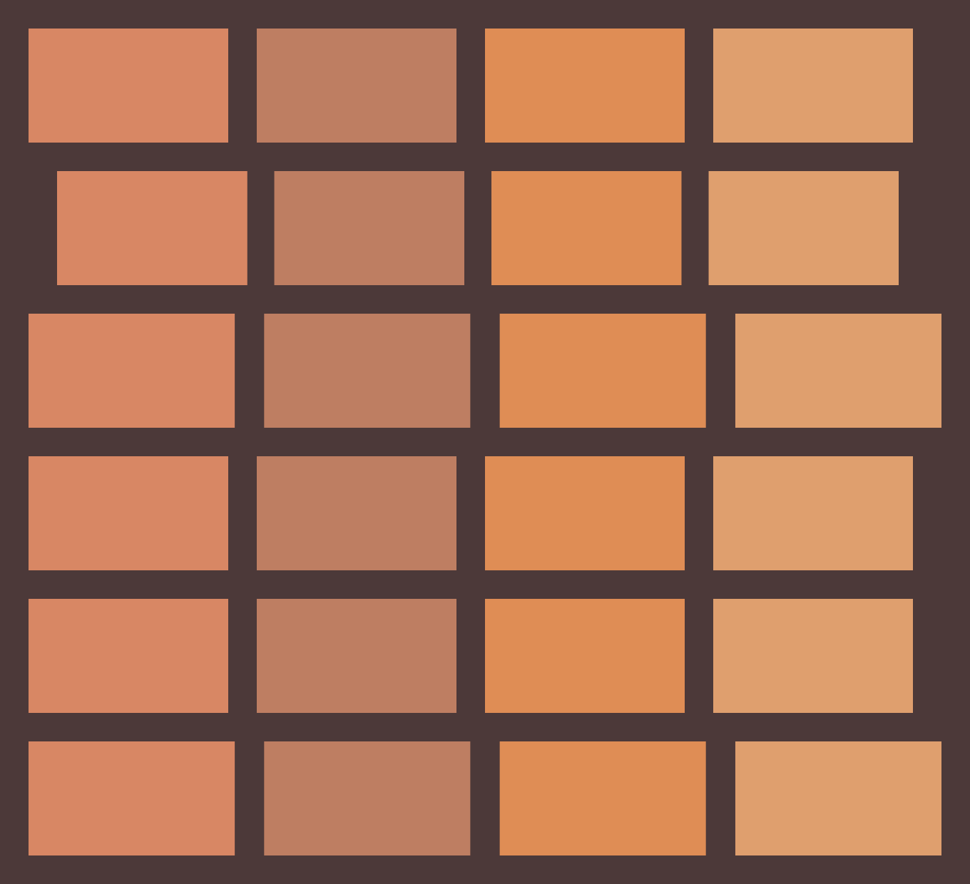
What does the word Built-in Mean?
Built-in’s simply means “it comes with” the Game engine or system by default.
Special variables and data types are common examples of built-ins in the Godot Game Engine

Slide 5
What is a Variant in Godot
A variant is a class designed to store a variety of other datatypes.
This simply means a variant can store almost any datatype.
They can be stored in variables and passed to other functions.
Godot loves variants and they are built to the core of Godot.
GDScript automatically wrap values in them. It keeps all data in plain Variants by default and then optionally enforces custom static typing rules on variable types.

Slide 6
What is a Callable?
A Callable is a built-in variant type that represents a function
Callables are mostly used for signal callbacks.

Slide 7
What is a Signal in Godot?
A Variant type that represents data called from an object instance
Or in English….
Signals are a way or how nodes can communicate by sending out messages (data) that other nodes can sense, find, detect, and react to.
To use a signal, you have to connect them to any node you want the signal to listen to (receive)….basically the node should “subscribe” to the signal broadcast.

Slide 8
Example using signals
Objective: We want to destroy a player object if it collides with an enemy object
Enemy
Player
How do we do this?
Enemy
Player
Player Touched enemy Signal

Slide 9
Player Touched enemy Signal
Yes, Player Touched Enemy
Destroy Player
Remove 10 points from Player Score

Slide 10
Facts about Signals
Signals can be very confusing and appear to work like magic. This is so because signals can be called from virtually anywhere in a project
So as a program starts getting larger, it may seem quite challenging to look under the hood and grasp what is happening.
Organization is key especially when using signals. This way it’s easier to see the broad picture.
Signals are Godot’s implementation of the Observer Game Design Pattern

Slide 11
How are signals created?
Signals can be created via the inspector in Godot (Godot loves signals and has created thousands of them by default)
Or you can create signals manually using code.
Let’s GODOT!!!!!!!

